Slide 1
Déjà vu: A Contextualized
Temporal Attention Mechanism
for Sequential Recommendation
ADVISOR: JIA-LING KOH
PRESENTER: CHENG-WEI CHEN
SOURCE: WWW’20
DATE: 2022/4/19

Slide 2
Outline
01
03
02
04
Introduction
Experiment
Method
Conclusion

Slide 3
Outline
01
Introduction
Problem
Previous Work
Target

Slide 4
Problem
User u
Input: Previous L items sequence records
Item i
Output: Probability of next items user will interacts with

Slide 5
Previous work
Transitional structure among the sequential actions largely ignore temporal and context information.
The more recent interactions should more closely represent the user intention.
Since user closely examined several options (much shorter time intervals in between than the average), these interaction can estimate current user preference.

Slide 6
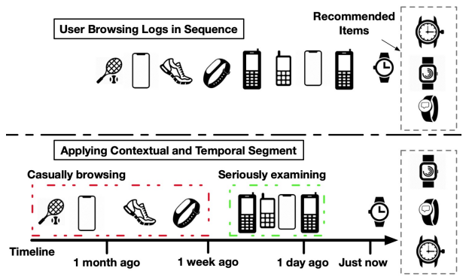
Comparison

Slide 7
Target
User u
Input: Previous L items & time sequence records
Item i
Time t
2022/3/6
15:00
2022/3/8
18:20
2022/3/28
12:50
2022/3/28
14:20
2022/3/28
15:10
Action
click
click
bookmark
purchase
purchase
Output: Probability of next items user will interacts with

Slide 8
Outline
01
03
02
04
Introduction
Experiment
Method
Conclusion

Slide 9
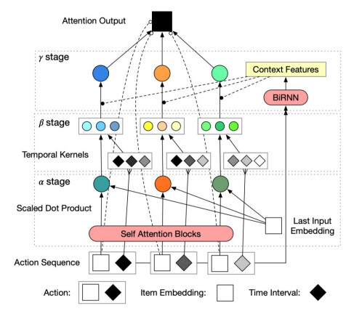
Architecture
γ stage: Fuse content & temporal influence based on the extracted context information.
β stage: Determine past events’ influence based on temporal gaps from current moment.
α stage: Obtain content-based importance score α for item sequence X
Time Interval
Item embedding sequence

Slide 10
α stage
備註
dh: heads, da: hidden units
X serve as the input H0
做dh次後得
反覆j次
Last item input embedding
Lx1

Slide 11
β stage
Time Interval
K kernel functions
LxK

Slide 12
γ stage
BiRNN concat Action
Element wise product
Combine α, β, C to γ
Lx1
Lx1
LxK
Kx1
γ to input sequence
doutx1
1xL
Lxdin
Nxdout
doutx1
Candidate Items’ score
Candidate Items

Slide 13
Loss Function
This paper use TOP1 loss
ri : positive sample score
rj : negative sample score

Slide 14
Outline
01
03
02
04
Introduction
Experiment
Method
Conclusion

Slide 15
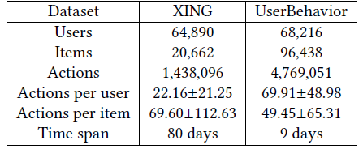
Dataset

Slide 16
Result
Traditional
RNN based
Attention based

Slide 17
Result

Slide 18
Result

Slide 19
Outline
01
03
02
04
Introduction
Experiment
Method
Conclusion

Slide 20
Conclusion
Efficiency. Compared with baseline, CTA improves recommendation quality by modeling the contextualized temporal information.
Customizability. α stage extract the content-based importance. β stage adapt different temporal kernels to encode knowledge of recommendation task. γ stage incorporate extra context information from the dataset.
Interpretability. Featuring three stage mechanism analysis demonstrated in experiments have a reasonable understanding on why an item is recommended.

Slide 21
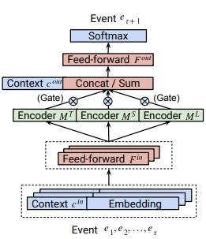
M3R

